Slide 1
National Forum On Youth Violence Prevention
The Los Angeles Mayor’s Office of Gang Reduction and Youth Development
Guillermo Cespedes, MSW - Deputy Mayor

Slide 2
LOS ANGELES GANG INFORMATION
Los Angeles has an estimated 400 gangs with approximately 41,000 active gang members (families)
There are currently 43 gang injunctions issued by the City Attorney’s office against 71 gangs in the city
Los Angeles County has an estimated 1,200 gangs with 80,000 gang members
Approximately 774,000 gang members nationwide (National Gang Center, 2008)
Notes:
Pictures are of former Gang Members that are apart of the Victory Outreach church

Slide 3
HISTORY OF PROGRAMS IN LA
The Group Guidance Project- 1940’s. Founded by LA Probation Dept. Emphasis on African American Gangs in South LA
The Ladino Hills Project (Malcolm Klein)- 1967. East LA, CA
Youth Gang Services- 1980-mid 90’s
LA Bridges mid-90’s to 2008
Gang Reduction Program in Boyle Heights 2003-2008
Notes:
Pictures are of former Gang Members that are apart of the Victory Outreach church

Slide 4
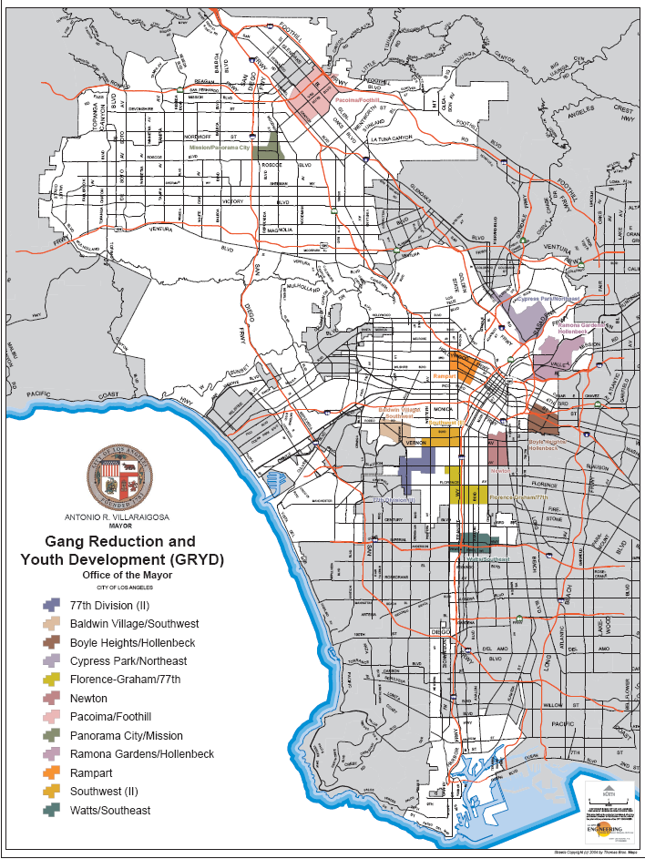
FOCUSING ON HIGH GANG VIOLENCE AREAS
Location of GRYD Zones
Central L.A.
Rampart
East L.A.
Boyle Heights/Hollenbeck
Ramona Gardens/Hollenbeck
Cypress Park/Northeast
South L.A.
Baldwin Village/Southwest
Southwest II
Newton
Florence-Graham/77th
77th II
Watts/Southeast
Valley:
Pacoima/Foothill
Panorama City/Mission
Other Communities
Harbor/Gateway
Venice
Canoga Park
Belmont
Sun Valley
Watts
Highland Park
Wilshire

Slide 5
GRYD ZONE SNAPSHOT
The average GRYD zone is approximately 3.5 square miles
Almost 40% of the total population in our GRYD zones is youth under the age of 18.
Gang related violence is 40% higher in the GRYD zones than other parts of the city.
55% of LAUSD foster children attend elementary and middle schools that serve our GRYD zones
31% of probation youth in Los Angeles attend schools that serve our GRYD zones.
Almost 30% of all families in the GRYD zones live below the poverty line, with a median household income close to $30,000. (19% for the rest of the city)

Slide 6
THE LOS ANGELES GRYD COMPREHENSIVE STRATEGY
GRYD Strategy Approaches
Primary Prevention | Secondary Prevention | Intervention Case Management | Intervention Violence Interruption | Suppression
Gun Buy-Back GRYD Cabinet Community Action Teams Community Education Campaign | GRYD Gang Prevention Services Family Centered Model | Family-Based Case Manage-ment Reentry referrals and services | Crisis Response Proactive peace-making activities Los Angeles Violence Intervention Academy | On-going communication with law enforcement agencies Coordination of services after suppression activities (e.g., “take-downs”/ Operation Ceasefire)
 | Female Responsive Programming GRYD Interdisciplinary Teams
Community and Law Enforcement Engagement Summer Night Lights Program Evaluation

Slide 7
Challenge of a Comprehensive Strategy
Do program components have a coherent theoretical framework?
Are practice approaches driven by that theoretical framework?
How does this impact evaluation?
Primary
Prevention
Social Identity
Theory
Secondary
Prevention
Suppression
Individual
Family
Community
Intervention
Case
Management
Community
Engagement
Family Systems
Theory
Intervention
Violence Interruption
Notes:
7

Slide 8
Theory of Change for the GRYD Comprehensive Strategy
KEY ASSUMPTIONS:
A multi-systemic, multi-level approach is needed to address individual, family, school, peer, and community risk factors simultaneously.
2. Youth and families are often disconnected from multigenerational family relationships.
Fragmented family structures erode parental/caretaker authority.
The programmatic focus on altering behaviors rather than identity is less likely to reinforce the gang culture.
Youth “differentiated” from the gang culture and connected to family and/or positive adults are less likely to engage in gang violence.
Individual, Family,Community Risk Factors for Gang Membership/Involvement & Gang Violence
Family Life Cycle
The Vertical Strategy: Multigenerational Coaching
Long-Term Outcomes
Short-Term Outcomes
The Horizontal Strategy: Problem-Solving Approach
Intermediate Outcomes
Relational Triangles

Slide 9
Details on: The Comprehensive Strategy Components
Primary
Prevention
Primary Prevention
Secondary Prevention
Intervention Violence Interruption
Intervention Case Management
Community Engagement
Suppression
Summer Night Lights
Evaluation
Secondary
Prevention
Intervention
Violence Interruption
Intervention
Case Management
Community
Engagement
Suppression
Summer Night Lights
Evaluation
Notes:
9

Slide 10
Now: Primary Prevention
Primary
Prevention
Gun Buy Back
Public Awareness Campaign
2009- (1,696 firearms)
2010- (2,511 firearms)
2011- 2,060 firearms)
GRYD Cabinet
City/County Wide Action Body
Family Life Cycle
Community Action Teams (CAT)
GRYD Zone Level Action Body
Family Life Cycle Projects
Community Education Campaign
Public Awareness Campaign
School Based
Primary Prevention
Gun Buy Back
Public Awareness Campaign
2009- (1,696 firearms)
2010- (2,511 firearms)
2011- 2,060 firearms)
GRYD Cabinet
City/County Wide Action Body
Family Life Cycle
Community Action Teams (CAT)
GRYD Zone Level Action Body
Family Life Cycle Projects
Community Education Campaign
Public Awareness Campaign
School Based
Secondary Prevention
Intervention Violence Interruption
Intervention Case Management
Community Engagement
Suppression
Summer Night Lights
Evaluation
Secondary
Prevention
Intervention
Violence Interruption
Intervention
Case Management
Community
Engagement
Suppression
Summer Night Lights
Evaluation
Notes:
10

Slide 11
Now: Secondary Prevention
Primary
Prevention
GRYD Model of Practice:
Focus on ages 10-15
Family, peer and individual risk factors (YSET)
The conceptual framework of the GRYD Model is anchored in two interrelated strategies:
The Vertical Strategy
The Horizontal Strategy
Genograms
Secondary
Prevention
Intervention
Violence Interruption
Intervention
Case Management
Community
Engagement
Suppression
Summer Night Lights
Primary Prevention
Secondary Prevention
GRYD Model of Practice:
Focus on ages 10-15
Family, peer and individual risk factors (YSET)
The conceptual framework of the GRYD Model is anchored in two interrelated strategies:
The Vertical Strategy
The Horizontal Strategy
GenogramsIntervention Violence Interruption
Intervention Case Management
Community Engagement
Suppression
Summer Night Lights
Evaluation
Evaluation
Notes:
11

Slide 12
Now: Secondary Prevention
Primary
Prevention
Individual
Secondary
Prevention
Intervention
Violence Interruption
Family
Community
Intervention
Case Management
Horizontal Strategy
Vertical Strategy
YSET Helps to Measure Change in Behaviors
Community
Engagement
Increase Self-Differentiation
Multigenerational strengths
Improve Structure
Reduce Problem Behaviors
Suppression
Summer Night Lights
Decrease Gang Membership
Evaluation
Notes:
12

Slide 13
Now: Intervention Violence Interruption
Primary
Prevention
Relational Triangles
A two person relational system is inherently unstable when subjected to sufficient levels of tension → The historical relationship between law enforcement and intervention
A third person, object, etc. can serve to reduce the levels of tension → A GRYD staff member
Relational triangle comprised of fluid roles that are interchangeable and affirming → emotional stability and competence in each individual that is a part of the triangle
Gang Intervention
Law Enforcement GRYD Staff
Secondary
Prevention
Intervention
Violence Interruption
Intervention
Case Management
Community
Engagement
Suppression
Summer Night Lights
Evaluation
Notes:
13

Slide 14
Now: Intervention Violence Interruption
Primary
Prevention
Mayor’s GRYD Office staff has responded to 1596 gang related incidents throughout the City of Los Angeles between April 2009 to April 2011
GRYD Staff have responded to incidents involving a total of 204 gangs
GRYD Office has identified the following sets that impact the GRYD zones:
50 Crip sets
24 Blood sets
130 Latino sets
Reduction of Retaliation
Enhanced Communication
Program Development
Victims Assistance
Community Engagement
Affirming Law Enforcement Relationships
Secondary
Prevention
Intervention
Violence Interruption
Intervention
Case Management
Community
Engagement
Suppression
Summer Night Lights
Evaluation
Notes:
14

Slide 15
Violence Reported to Police or Community Members
GRYD Staff Notified
Community Intervention Worker (CIW) Notified
GRYD Staff and/or Intervnetion Worker contact LAPD to collect information
On-going information gathering process begins to determine if the crime was gang-related or has the potential for retaliation in the community
Crime is gang-related or has the potential for retaliation
Unclear whether crime is gang-related or has potential for retaliation
Crime is not gang-related/no potential for retaliation
Activity at crime Scene and/or hospital
No activity at crime scene or hospital
GRYD & CIW gather more info.—CIW may be deployed
No Deployment unless need for rumor control
GRYD Staff & CIW Respond to the scene
Immediate Objectives (Up to 72 Hours After Notification of the Event):
GRYD, CIW, and/or LAPD collect and disseminate accurate information to defuse potentially volatile situations—i.e., rumor control.
GRYD, CIW, and/or LAPD identify and provide mediation across/within individuals, families, and/or gangs.
GRYD, CIW, and/or LAPD make contact with the victim’s family and facilitate the connection to services if appropriate and needed.

Slide 16
Figure 1: An Overview of the GRYD Intervention Crisis Response (Model of Practice—Continued)
GRYD Staff
Community Intervention Worker (CIW)
LAPD
On-going communication and assessment of information between the partners of the triangle as well as from community members, gangs, and any other source in order to address the following objectives:
Intermediate Objectives (Up to 2 Weeks After Notification of the Event):
GRYD, CIW, and/or LAPD will:
Engage community members who could benefit from prevention and intervention services.
Help victim’s family get information and link to victim assistance programs and/or other needed services (e.g., funeral services, trauma/grief counseling, etc.)
Maintain a peaceful environment through community rituals and funeral services.
On-going monitoring of and response to “hot spots.
Develop peace-making agreements across gangs where appropriate.
Long-Term Objectives (On-Going):
GRYD, CIW, and/or LAPD will:
On-going engagement/referrals to prevention and intervention services for those involved and/or close to the incident.
On-going “check-in” with the victim’s family to make sure they have access to needed services.
On-going monitoring of and response to “hot spots.”
Identify the need for additional services in the community such as the Summer Night Lights Program, peace marches, and so on.

Slide 17
Now: Intervention Violence Interruption
Primary
Prevention
Los Angeles Violence Intervention Training Academy (LAVITA)
Provides training and certification for intervention workers.
Basic 140 hr course, 2 continuing education modules per year (20-30 hrs)
Curriculum:
Direct Practice
Personal Development
Concrete Tasks
Applied Theory
Broader Policy Issues
(LAVITA is administered by the Advancement Project)
Secondary
Prevention
Intervention
Violence Interruption
Intervention
Case Management
Community
Engagement
Suppression
Summer Night Lights
Evaluation
Notes:
17

Slide 18
Now: Intervention Case Management
Primary
Prevention
Secondary
Prevention
Client Selection Tool
Family Based Case Management
Relationship Systems
Outcome Measures
Intervention
Violence Interruption
Intervention
Case Management
Community
Engagement
Suppression
Summer Night Lights
Evaluation
Notes:
18

Slide 19
Now: Community Engagement
Primary
Prevention
Secondary
Prevention
Intervention
Violence Interruption
Summer Night Lights
Law enforcement community strategies
Work with faith-based communities
Engagement of local vendors
Intervention
Case Management
Community
Engagement
Suppression
Summer Night Lights
Evaluation
Notes:
19

Slide 20
Now: Suppression
Primary
Prevention
Secondary
Prevention
Intervention
Violence Interruption
Community Engagement and Support Services after large scale suppression activities (i.e. multi-task force take-downs)
Intervention
Case Management
Community
Engagement
Suppression
Summer Night Lights
Evaluation
Notes:
20

Slide 21
Now: Summer Night Lights
Primary
Prevention
Engage the “customers” that are most likely to be victims or perpetrators of violence.
Engage the neighborhoods with the highest propensity for violence.
Establish programming during the days of the week, the times of the day, and the period of the summer in which violence is most likely to spike.
Involve all members along the life cycle from toddlers to elders.
Engage intervention workers in planning and programming.
Develop strategies that promote community-law enforcement engagement.
Hire youth that are close to the culture of violence, but not fully imbedded in it.
Focus on behavior not identity.
Provide jobs to residents along the entire family life cycle.
Engage formal and informal stakeholders.
Use local vendors so that neighborhood economy is supported.
Secondary
Prevention
Intervention
Violence Interruption
Intervention
Case Management
Community
Engagement
Suppression
Summer Night Lights
Evaluation
Notes:
21

Slide 22
Now: Summer Night Lights
Primary
Prevention
HISTORY OF SUMMER NIGHT LIGHTS
Piloted 2002, 2003 in Baldwin Village- (Summer of Success)
27% reduction in gang related crime
1 homicide over two summers
2009 - SNL Expanded to 16 sites
270,000 visits
25% reduction in homicides
25% reduction in victims shot
2008 - SNL Expanded to 8 sites
50, 000 visits
86% reduction in gang related homicides
45% reduction in victims shot
2010 – SNL Expanded to 24 sites
An estimated 710,000 visits
A total of 382,523 meals served throughout all sites
Over 1,000 jobs made available during SNL program
40% reduction in gang-related part 1 crimes for all SNL locations combined
57% reduction in gang-related homicides
2011 Program expanded to 32 sites
SNL is a Public/Private Partnership
Secondary
Prevention
Intervention
Violence Interruption
Intervention
Case Management
Community
Engagement
Suppression
Summer Night Lights
Evaluation
Notes:
22

Slide 23
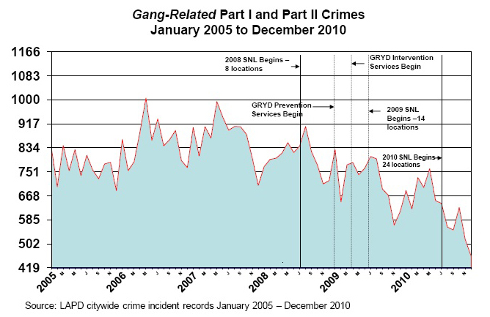
Now: Evaluation Highlights
Primary
Prevention
Since implementation, GRYD communities have collectively experienced a decline in gang-related crimes of 17%, compared to 11% in non-GRYD communities.
Youth participating in GRYD prevention programs show a 49% decrease in involvement in gang activities and gang fights and a 39% decrease in involvement with gang members after 6 months of participation.
Participating youths also show significant attitudinal and behavioral improvements, including a 21% decrease in impulsive risk taking and a 29% decrease in skipping class.
Gang-related crimes in parks with Summer Night Lights events have declined 27% in the past four years.
Over 1,000 jobs and over 380,000 meals were made available to communities during the 2010 Summer Night Lights season
Secondary
Prevention
Intervention
Violence Interruption
Intervention
Case Management
Community
Engagement
Suppression
Summer Night Lights
Evaluation
Notes:
23

Slide 24
Now: Evaluation Highlights
Primary
Prevention
Over 80% of LAPD officers reported “improvement” in each of the following areas over the past year:
Training for intervention workers and law enforcement
Information exchange between LAPD, intervention workers, and the community
Community tension levels after gang incidents
Control of retaliation after a gang incident
LAPD/intervention staff cooperation after a crisis incident
LAPD/GRYD cooperation after a crisis incident
Secondary
Prevention
Intervention
Violence Interruption
Intervention
Case Management
Community
Engagement
Suppression
Summer Night Lights
Evaluation
Notes:
24

Slide 25
Los Angeles Mayor Antonio Villaraigosa Office of Gang Reduction and Youth Development
200 N. Spring Street, Room 2225
Los Angeles CA 90012
(213) 473-7796
http://mayor.lacity.org
Issues- Gang Reduction

